Slide 1
Coursera Capstone project
Hotel recommendation system
By Noor Qarabash

Slide 2
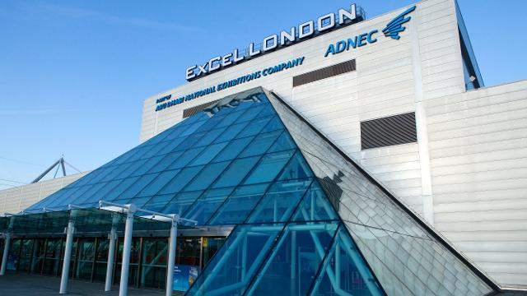
Business Problem
The ExCel event center in London hosts a lot of international events yearly and for a lot of people attending or orginazing these events searching for hotel accommodation is very important
This Project attempts to find an evaluation score for hotels in the area to provide hotel recommendations.

Slide 3

Data
This project uses Foursequre API to collect data about hotels in the area around the Excel center.
The data include : The name of the hotel, id, rating, distance from Excel center and number of restaurants nearby and the coordinates we will use for visualization

Slide 4
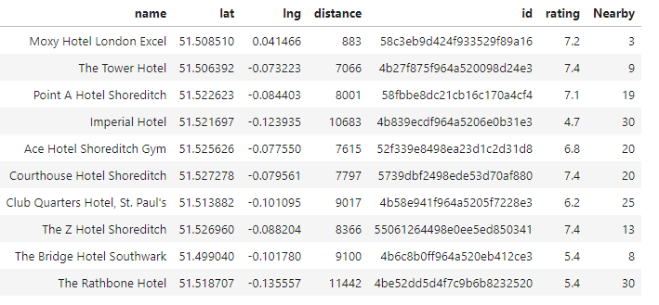
Data

Slide 5
Score calculation
We use 3 feature to evaluate hotels:
Distance, Nearby (restaurants), Rating
All 3 are first normalized to a range from 0-1
We want the rating and nearby values to be high but the distance should be low
We used the equation
Score = (Rating+ Nearby restaurants-distance)/2*10
Dividing by 2 then multiplying by 10 simply converts the score from the 0-2 range to 0-10 range

Slide 6
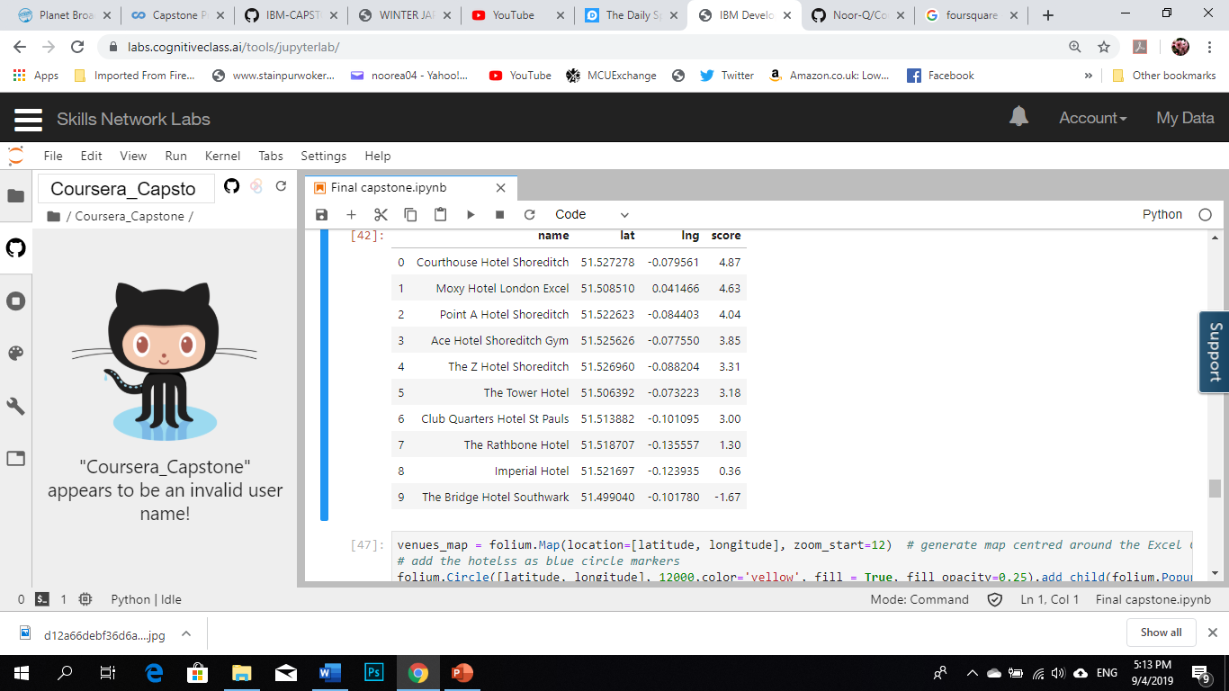
Results

Slide 7
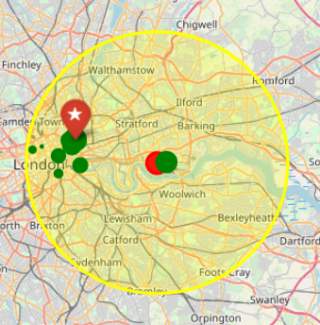
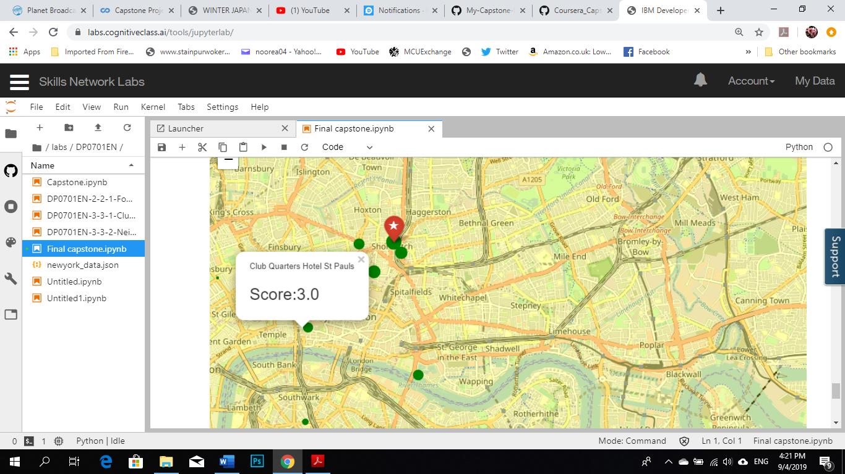
Visualization

Slide 8
Conclusion
This project presented a simplified recommendation system that can offer event attendees a list of suggested hotels evaluated based on features that would make their experience of an even better. The result is a list of 10 hotels ranked based on a combination of the distance, rating and nearby restaurants attributes. The results were visualized on an easily readable map that any event attendee can use to identify the ideal hotel for them.

